Slide 2
Presentation style guide
Format: Use this template for all ECCO Presentations
Font: Roboto
Colours: Use colours pre-set in this template

Slide 3
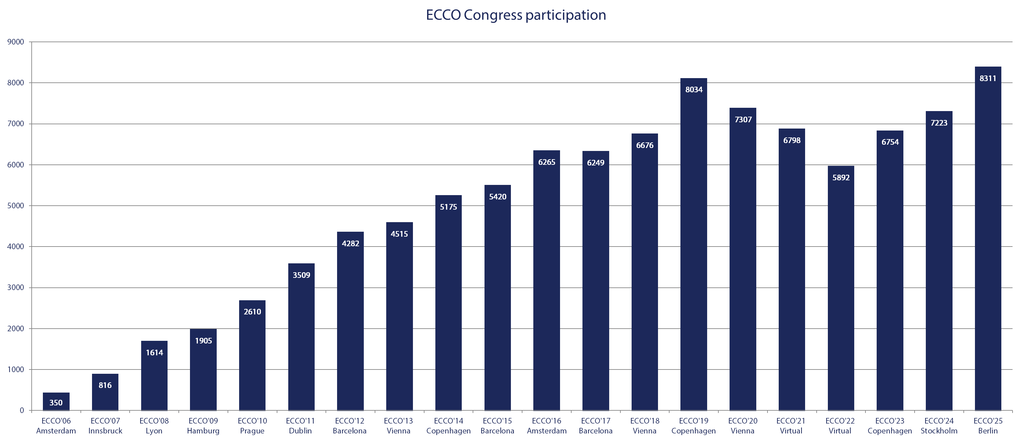
Sample statistic

